Slide 1


Implementation of Neuromorphic Hearing Aid with Noise Suppression
VE3411 PROJECT WORK-Ⅱ
Guided By,
Mr.K.Veerappan
Department of Electronics Engineering
MIT, Anna University.
Presented by,
Jerome Albert A
2023617030
M.E(VLSI DESIGN AND EMBEDDED SYSTEMS)

Slide 2
INTRODUCTION
Hearing loss affects millions of people worldwide, Traditional hearing aids amplify all sounds, including background noise, making speech comprehension difficult in noisy environments.
To address this issue, neuromorphic computing and cochlea-inspired signal processing offer a promising approach to enhance speech clarity while reducing background noise in real time.
This project aims to develop a neuromorphic hearing aid that utilizes Spiking Neural Networks (SNNs) for real-time noise suppression and speech recognition. Inspired by the human cochlea.
The Raspberry pi microcontroller will serve as the processing unit, interfacing with an I2S MEMS microphone for real-time audio capture and a speaker/earphone for output.

Slide 3
Problem Statement & Motivation
Problem Statement: Hearing aids often struggle to separate speech from background noise, making conversations difficult in noisy environments. Traditional noise reduction techniques may distort speech or fail to suppress unwanted sounds effectively.
Motivation:
Improving Communication : People with hearing impairments face challenges in understanding speech in noisy settings (e.g., streets, cafes).
Beyond Conventional ANC : Unlike Active Noise Cancellation (ANC) in earbuds, which suppresses all background noise, this system selectively enhances speech while preserving critical sounds like sirens and horns.
Neuromorphic Efficiency : Inspired by how the human cochlea processes sound, this approach mimics biological hearing mechanisms and integrating with Neuromorphic computing makes it energy efficient.
Real-World Application : Enables better hearing assistance in everyday situations, from one-on-one conversations to public spaces.
.

Slide 4
OBJECTIVE
To design and implement a real-time hearing aid system inspired by the human cochlea that can effectively suppress background noise and enhance speech clarity using neuromorphic computing and Spiking Neural Networks (SNNs).
Mimic Human Cochlear Processing.
Real-Time Noise Suppression & Speech Enhancement.
Real-Time Processing with Low Latency.

Slide 5
LITERATURE SURVEY
Journal details | Authors | Inference
1)Title: Towards Ultra-Low-Power Neuromorphic Speech Enhancement with Spiking-FullSubNet. Journal: Electrical Engineering and System Sciences Year: 2024 | Xiang Hao et al. | Presents a novel Spiking Neural Network (SNN) model called Spiking-FullSubNet, designed for real-time speech enhancement. This model integrates both full-band and sub-band information to capture global and local spectral characteristics of speech signals. It introduces a Gated Spiking Neuron (GSN) model to dynamically control input information.

Slide 6
LITERATURE SURVEY
Journal details | Authors | Inference
2)Title: Neuromorphic acoustic sensing using an adaptive microelectromechanical cochlea with integrated feedback Journal: Nature Electronics Year: 2024 | Claudia Lenk et al. | The paper presents a bio-inspired acoustic sensor system that mimics the human cochlea using a microelectromechanical system (MEMS) with integrated real-time feedback. This adaptive system dynamically switches between linear and nonlinear characteristics to enhance signal detection in noisy environments, increase the sensor's dynamic range, and adapt to changing acoustic conditions. The study demonstrates that the system's performance is comparable to mammalian hearing, with significant improvements in sensitivity and frequency coverage through output-signal coupling between sensors

Slide 7
LITERATURE SURVEY
Journal details | Authors | Inference
3)Title: Single Channel Speech Enhancement Using U-Net Spiking Neural Networks Journal: IEEE Canadian Conference on Electrical and Computer Engineering (CCECE) Year: 2023 | Abir Riahi and Éric Plourde | The paper proposes a novel approach to single-channel speech enhancement using Spiking Neural Networks (SNNs) based on a U-Net architecture. They used Surrogate Gradient, provide an alternative way to compute gradients in SNNs. The model leverages the energy-efficient nature of SNNs to process speech data with a temporal dimension, achieving comparable performance to state-of-the-art Artificial Neural Network (ANN) models while significantly reducing energy consumption.

Slide 8
LITERATURE SURVEY
Journal details | Authors | Inference
4)Title: Neuromorphic Lip-Reading with Signed Spiking Gated Recurrent Journal: IEEE Explore Year: 2024 | Manon Dampfhoffer and Thomas Mesquida | The paper introduces a novel Spiking Neural Network (SNN) model called Signed Spiking Gated Recurrent Unit (SpikGRU2+) for Automatic Lip-Reading (ALR) using event-based vision sensors. This model leverages the sparse and event-driven nature of SNNs to achieve high accuracy and low power consumption. The SpikGRU2+ model outperforms previous state-of-the-art SNN and ANN models on the DVS-Lip dataset, improving accuracy by 25% and 4% respectively. Additionally, the model optimizes spike sparsity, reducing the number of operations by up to 22x compared to ANNs.

Slide 9
LITERATURE SURVEY
Journal details | Authors | Inference
5)Title: Exploring Neuromorphic Computing Based on Spiking Neural Networks: Algorithms to Hardware. Journal: ACM Computing Surveys Year: 2023 | Nitin Rathi, Indranil Chakraborty et al. | The paper provides a comprehensive overview of the advancements in neuromorphic computing, focusing on Spiking Neural Networks (SNNs). It highlights the interdisciplinary approach of combining neuroscience-inspired algorithms with efficient hardware design to achieve brain-like efficiency in machine intelligence. The study discusses the challenges and potential solutions in developing neuromorphic hardware that leverages event-driven sparse computations and efficient matrix operations. It also explores the promise of Non-Volatile Memory (NVM) technologies in implementing bio-mimetic functionalities on single devices

Slide 10
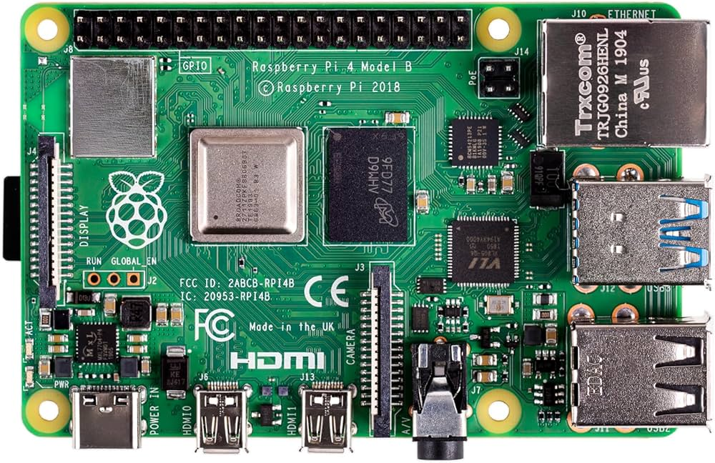
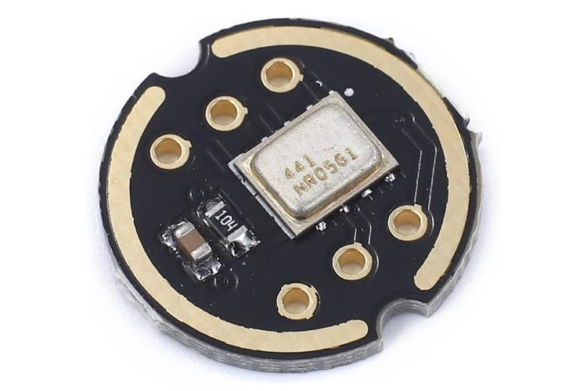
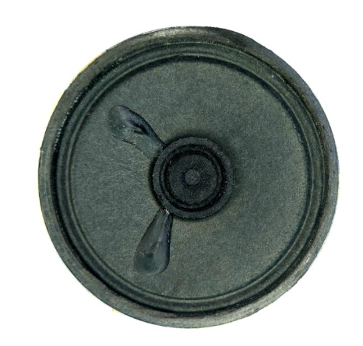
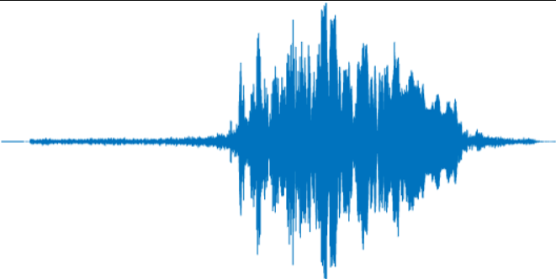
BLOCK DIAGRAM
Raspberry pi 4
Cochlea Inspired Processing
Spiking Full subnet
+ (GSN)
Audio signal
I2S MEMS Microphone
Processing Algorithm
Audio output through speaker
Audio feature extraction STFT, spectogram, rms…etc
Metric discriminator Loss function
Gammatone Filter Bank(frequency decomposition)

Slide 11
METHODOLOGY
Cochlea-Inspired Processing
Audio processing:
Perform audio processing like calculating rms value, extracting spectograms, STFT, ISTFT, Mag_phase
Gammatone/bark Filter Bank:
Spiking-FullSubNet with Gated Spiking Neurons (GSN)
Gated Spiking Neurons (GSN):
Hardware Implementation on raspberry pi
Audio Input:
Dynamically adjust decay rates to retain multi-scale temporal information.
FullSubNet Architecture:
Combines full-band and sub-band models for efficient frequency processing.
MEMS microphone captures audio via I2S.
Processing:
Cochlea-Inspired Processing and Spiking-FullSubNet algorithms.
Audio Output:
Cleaned audio sent to speaker/earphone via laptop
Decomposes audio into frequency bands (low, mid, high).
Extracts amplitude variations using the Hilbert Transform or low-pass filtering.
Differentiates speech from noise.

Slide 12
METHODOLOGY
Speech-Priority Filtering:
The system prioritizes enhancing speech while reducing background noise.
However, if no speech is detected, the algorithm does not aggressively suppress all background sounds. Instead, it can be adjusted to maintain awareness of loud, sudden noises.
Adaptive Noise Suppression (Threshold-Based Approach):
cochlea-inspired processing decomposes sound into frequency bands.
Sudden loud sounds (e.g., a horn, siren, or emergency alert) have distinct energy spikes in specific frequency bands.
This can be done by setting a dynamic threshold.

Slide 13
DATA PROCESSING PIPELINE
Preprocessing Steps
Noisy and Clean Audio Processing Steps
Feature Extraction Techniques Used
1. Feature Extraction:
Compute RMS Energy
Root Mean Square (RMS) used for energy estimation
Helps in signal normalization
Loudness Normalization:
Max Normalization & RMS Normalization
Ensures consistent volume across samples
Active RMS Calculation:
Determines speech & noise energy separately

Slide 14
DATA PROCESSING PIPELINE
2. Spectral Analysis
Short-Time Fourier Transform (STFT)
Extracts magnitude, phase, real, and imaginary components
Helps analyze frequency domain representation of speech
Complex Ideal Ratio Mask (cIRM)
Used for speech enhancement
Compressed & decompressed for noise suppression
3. Feature Transformations
Segmental RMS Normalization
Applied over time to improve dynamic range
SNR Gain Calculation
Adjusts the signal-to-noise ratio for better enhancement
dB Tuning
Adjusted to -26 dB FS for loudness consistency

Slide 15
DATA PROCESSING PIPELINE
4. Activity Detection & Band Dropping
Speech Activity Detector (VAD)
Identifies active speech frames vs silence
Dropped Band Processing
Removes unwanted noise components
Helps in robust feature extraction
5. Ideal Ratio Masking (IRM)
Speech & Noise Masks Generated
Helps separate speech from noise
Used for enhancement in the SNN model
Complex Multiplication with Decomposed Features
Enhances speech by reconstructing frequency component

Slide 16
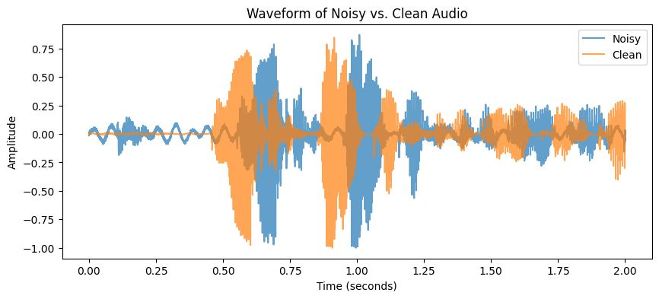
AUDIO PROCESSING-
INITIAL FEATURE EXTRACTION
Waveform comparison of Noisy vs. Clean audio.
The waveform represents the amplitude variations over time.
The noisy audio (blue) shows more fluctuations due to external interference.
The clean audio (orange) represents the original speech signal without added noise.
This step is crucial for analyzing the characteristics of both signals before further processing.

Slide 17
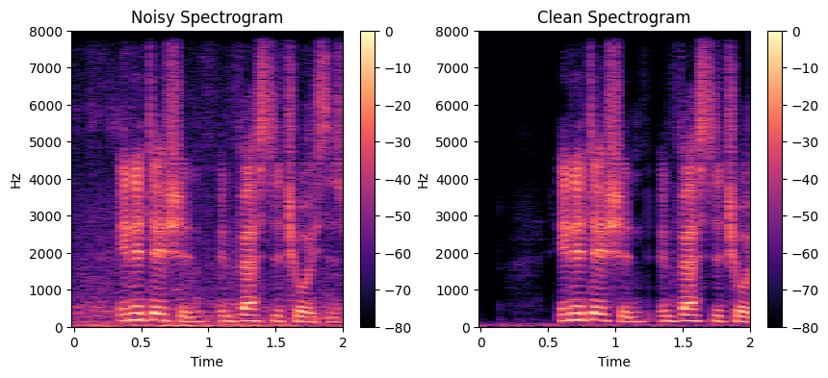
AUDIO PROCESSING-
INITIAL FEATURE EXTRACTION
Spectrogram of Noisy vs. Clean audio.
The spectrogram visualizes the frequency distribution of both signals over time.
The noisy spectrogram contains additional frequency components introduced by noise.
The clean spectrogram represents the original speech signal.
This analysis helps in understanding the frequency composition of both signals before applying further transformations.
Observation:
This feature extraction step provides insights into the spectral characteristics of noisy and clean audio.

Slide 18
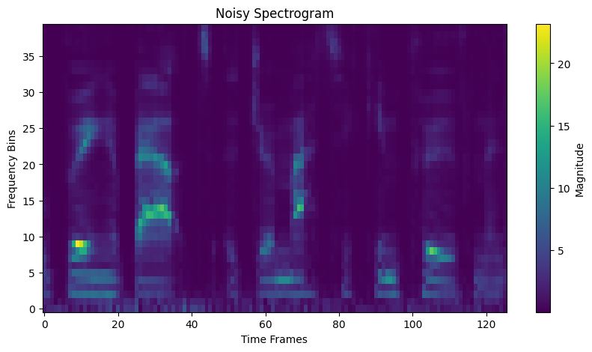
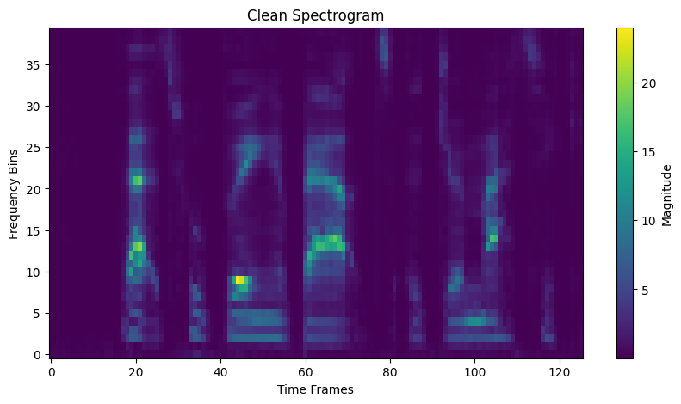
AUDIO PROCESSING-
BARK-FILTER FEATURE EXTRACTION
Magnitude Spectrograms:
Represents the strength of a frequency component at a given time.
Bright yellow regions (~20+ dB): High-energy parts of speech.
Dark blue regions (~0-5 dB): Low-energy regions.
Noisy Spectrogram:
This spectrogram is extracted from the noisy speech signal after applying the Bark filter.
The energy is more spread out high-energy artifacts (unwanted noise)
Clean Spectrogram:
This spectrogram is extracted from the clean speech signal after applying the Bark filter
The speech structure is more clearly defined (bright regions) more prominent.
The high-frequency noise is significantly reduced, making speech components more distinct.

Slide 19
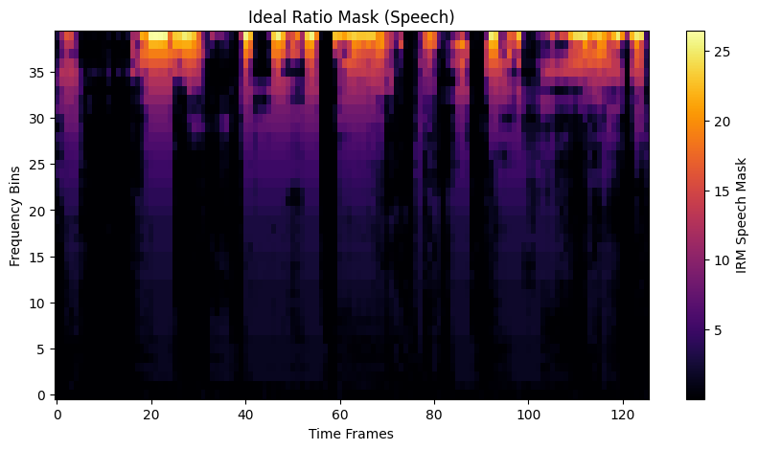
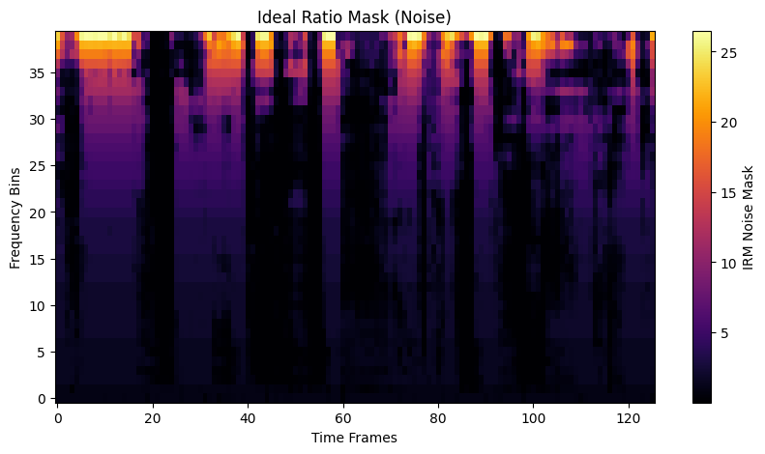
AUDIO PROCESSING-
BARK-FILTER FEATURE EXTRACTION
Ideal Ratio Mask from Bark Filtered Outputs:
Ideal Ratio Mask (Speech)
This mask is used in speech enhancement to retain speech-dominant regions and suppress noise.
Brighter regions (yellow/orange) indicate time-frequency areas where speech is dominant.
Darker areas represent regions where noise dominates, meaning these areas should be suppressed.
Ideal Ratio Mask (Noise)
This mask highlights time-frequency regions where noise dominates.
Brighter regions correspond to areas with high noise energy, while darker regions indicate parts of the spectrum where noise is minimal.
This mask is complementary to the speech mask and is used in noise suppression models.

Slide 20
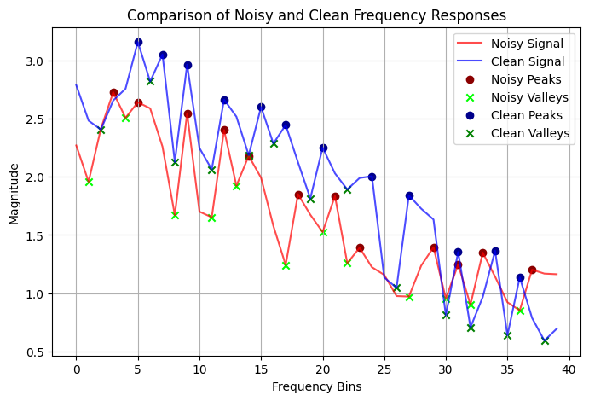
AUDIO PROCESSING-
BARK-FILTER FEATURE EXTRACTION
PEAKS AND VALLEY DISTRIBUTION:
The clean signal follows a smoother and more structured pattern, indicating a well-preserved spectral envelope.
The noisy signal has more fluctuations and distortions, meaning the noise introduces irregularities in frequency components.
Peaks (Dots): Represent dominant frequency components
Valleys (Green X-marks): Represent weaker spectral regions where energy is minimal.
The noisy signal deviates significantly from the clean signal, meaning background noise is distorting speech-relevant features.
The gap between clean and noisy peaks represents information loss due to noise.

Slide 21
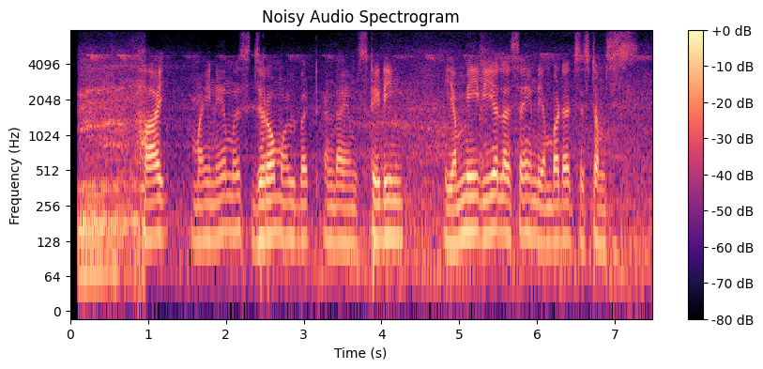
MODEL TRAINING CONFIGURATION
Sampling Rate and STFT Parameters:
The model uses a sampling rate of 16 kHz with STFT settings of n_fft=512 to process audio input.
Frequency Band Configuration:
Uses 64 filter bank frequencies and separates the spectrum using frequency cutoffs at
[32, 128, 192], organizing it into sub-bands for more focused processing.
Sequence Model Type:
The model applies a GSU (Gated Spiking Unit) as the main sequence model to capture temporal features effectively.
Sub-Band and Full-Band Network Architecture:
Both sub-band (SB) and full-band (FB) networks are used with dedicated hidden size subband =256, and fullband = 320 are configurations for center and neighbor frequencies.
64 filters to split the frequency spectrum of your audio into 64 bands.
Frequency range from 0 Hz to Nyquist frequency(8000,since sr=16000),each filter roughly covers a frequency band of about 125 Hz (8000 / 64).
Frequency Separation of Input for sub band

Slide 22
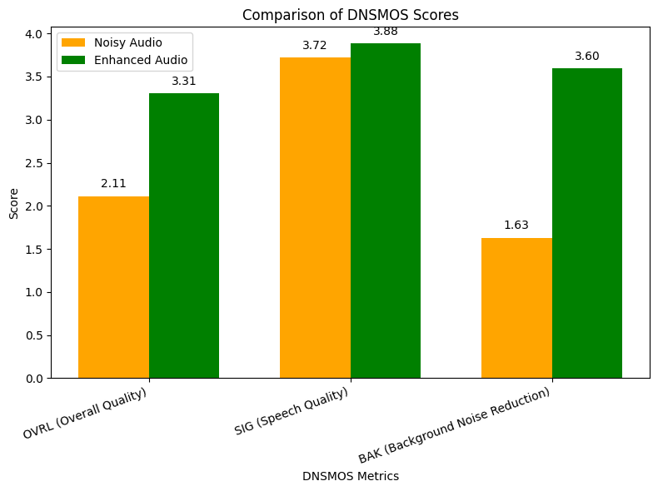
DNSMOS METRICS
DNSMOS SCORE | NOISY DATASET | AFTER TRAINING ENHANCEMENT
OVRL | 2.111115 | 3.30644
SIG | 3.719177 | 3.88166
BAK | 1.631128 | 3.59658
The model improves overall speech quality (OVRL) significantly.
The background noise reduction (BAK) is highly improved, indicating strong noise suppression.
Speech quality (SIG) remains stable, ensuring the voice remains natural.
The Spiking FullSubNet model successfully enhances speech by reducing background noise while maintaining speech clarity.
DNSMOS evaluation confirms significant improvement in perceptual speech quality.

Slide 23
SI-SNR METRICS
SI-SNR | BEFORE ENHANCEMENT (db) | AFTER ENHANCEMENT (db) | SI-SNRi (db)
 | 7.89 | 14.45 | 6.56
Initial Quality (Before Enhancement):
The original speech signal had a SI-SNR (Scale-Invariant Signal-to-Noise Ratio) of 7.89 dB, indicating moderate quality and presence of noise.
Enhanced Quality (After Enhancement):
After applying the enhancement method, the SI-SNR improved to 14.45 dB, showing a clear gain in speech clarity.
SI-SNR Improvement:
The SI-SNR increased by 6.56 dB, which reflects a significant enhancement in signal quality and intelligibility.
Impact of Enhancement:
The substantial SI-SNR gain confirms the effectiveness of the speech enhancement technique in reducing noise and improving audio quality.

Slide 24

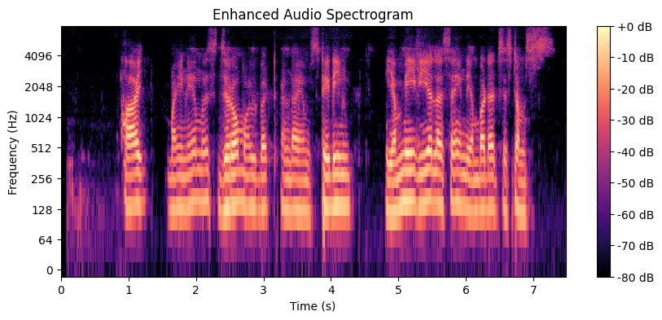
COMPARISON OF NOISY AND
ENHANCED AUDIO
The enhanced audio spectrogram shows less noise in high-frequency regions compared to the noisy input.
Speech components are more prominent and well-defined in the enhanced spectrogram.
Background noise energy has been significantly reduced, making speech intelligibility better.

Slide 25
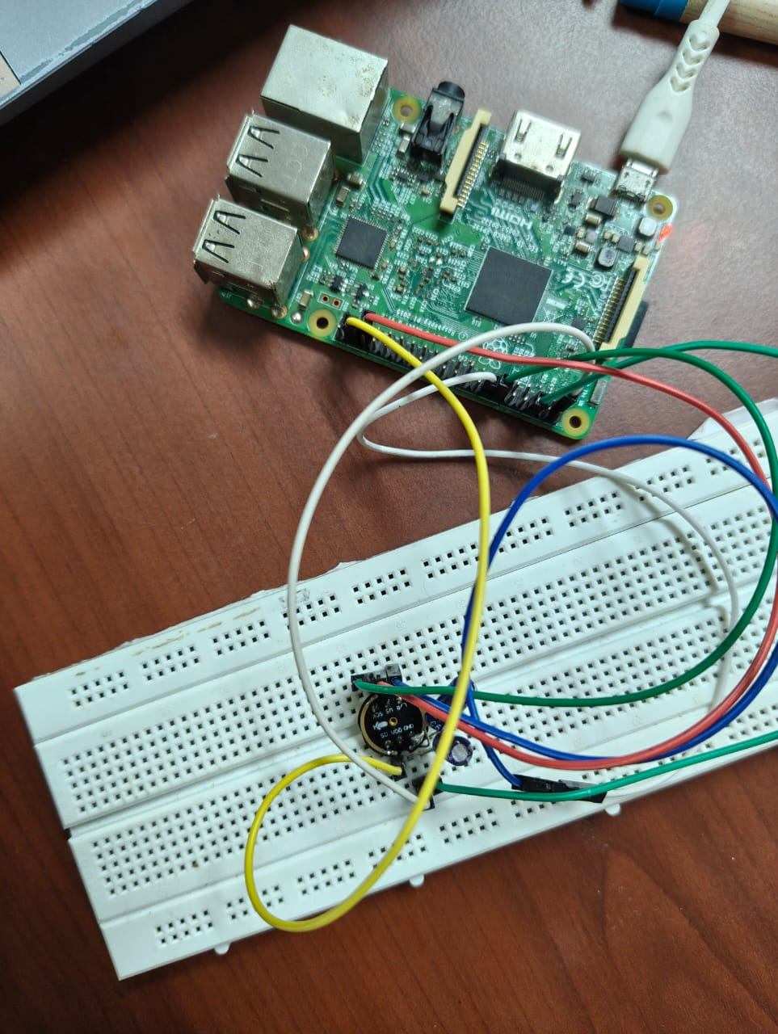
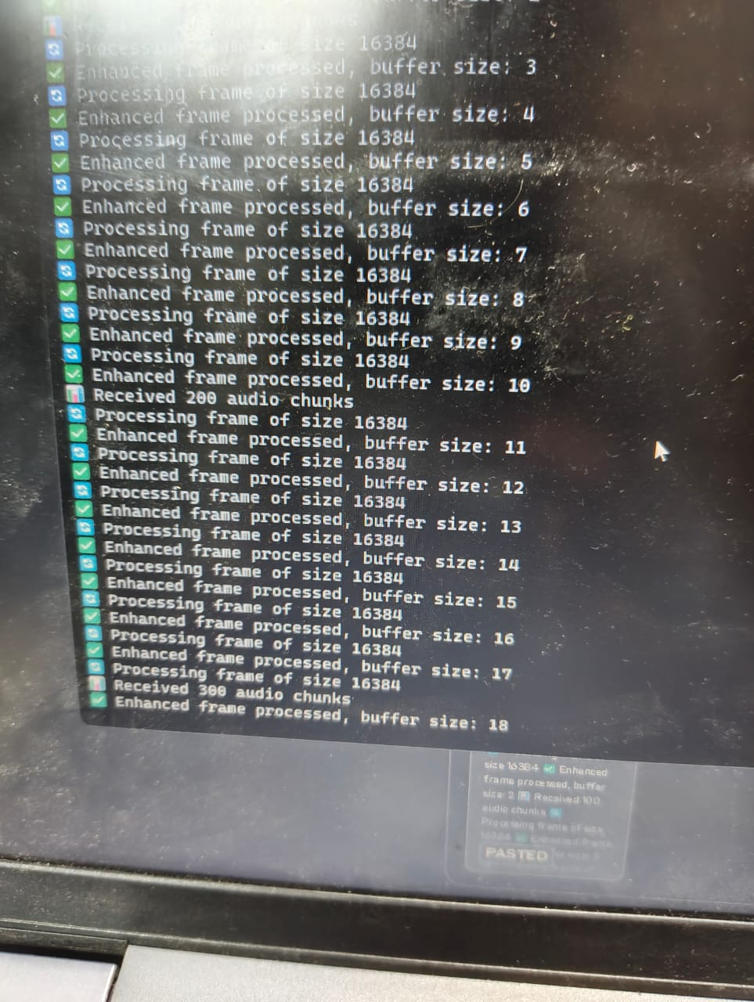
AUDIO ENHANCEMENT MODEL

Slide 26
WORK PLAN
Review 0
Review 1
Review 2
Review 3
Planning
Develop the Algorithm
Algorithm Implementation
Hardware Integration and Testing
Defining the objectives for the project. Researching through various papers. Hardware and software components finalise. | Learning about the algorithm Implementing required audio processing Implementing Cochlea sound processing | Implementing spiking full subnet and GSN Integrating cochlea sound processing and Spiking full-subnet +GSN. | Algorithm prototype implementing with hardware components. Test in Real-World Noise Conditions

Slide 27
REFERENCES
Xiang Hao, , Chenxiang Ma, Qu Yang, Jibin Wu, Kay Chen Tan, "Towards Ultra-Low-Power Neuromorphic Speech Enhancement with Spiking-FullSubNet." arXiv preprint arXiv:2410.04785 (2024).
Claudia Lenk , Philipp Hövel , Kalpan Ved, Steve Durstewitz, Thomas Meurer, Tobias Fritsch, Andreas Mannchen, Jan Küller, Daniel Beer, Tzvetan Ivanov1 & Martin Ziegler , Neuromorphic acoustic sensing using an adaptive microelectromechanical cochlea with integrated feedback. Nat Electron 6, 370–380 (2023). https://doi.org/10.1038/s41928-023-00957-5
Riahi, Abir, and Éric Plourde. "Single channel speech enhancement using u-net spiking neural networks." 2023 IEEE Canadian Conference on Electrical and Computer Engineering (CCECE). IEEE, 2023.
Dampfhoffer, Manon, and Thomas Mesquida. "Neuromorphic Lip-reading with signed spiking gated recurrent units." Proceedings of the IEEE/CVF Conference on Computer Vision and Pattern Recognition. 2024.
Rathi, N., Chakraborty, I., Kosta, A., Sengupta, A., Ankit, A., Panda, P., & Roy, K. (2023). Exploring neuromorphic computing based on spiking neural networks: Algorithms to hardware. ACM Computing Surveys, 55(12), 1-49.

Slide 28
REFERENCES
Hao, Xiang, et al. "When audio denoising meets spiking neural network." 2024 IEEE Conference on Artificial Intelligence (CAI). IEEE, 2024.
H. Taherian, Z.-Q. Wang, J. Chang, and D. Wang, “Robust speaker recognition based on single-channel and multi-channel speech enhance ment,” IEEE/ACM Transactions on Audio, Speech, and Language Pro cessing, vol. 28, pp. 1293–1302, 2020
Sun, Tao, and Sander Bohté. "DPSNN: spiking neural network for low-latency streaming speech enhancement." Neuromorphic Computing and Engineering 4.4 (2024): 044008
Henry, Fergal, Martin Glavin, and Edward Jones. "Noise reduction in cochlear implant signal processing: A review and recent developments." IEEE reviews in biomedical engineering 16 (2021): 319-331.
Yao, Xingting, et al. "Glif: A unified gated leaky integrate-and-fire neuron for spiking neural networks." Advances in Neural Information Processing Systems 35 (2022): 32160-32171.

